Slide 1

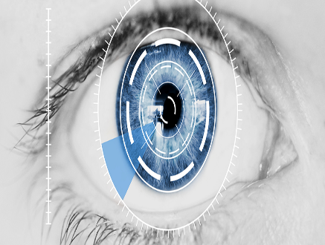
Presentation on Human Identification Using Iris Recognition
OF
BACHELOR OF TECHNOLOGY
IN
INFORMATION TECHNOLOGY
By
AADARSH PANDEY(10200215001) ABHISHEK GHOSH (10200215003)
AYAN CHOWDHURY(10200215011) BISHAL MUKHERJEE(10200215014)
Under the Guidance of
Dr. SATYENDRA NATH MONDAL
Department of Information Technology
Kalyani Government Engineering College
2018-2019

Slide 2

OUTLINES
1. INTRODUCTION 2. SEGMENTATION 3. NORMALISTION 4. FEATURE ENCODING & EXTRACTION 5. RESULTS AND DISCUSSION 6. CONCLUSION AND SCOPE FOR FUTURE WORK 7. REFERENCES

Slide 3

INTRODUCTION

Slide 4

OBJECTIVE/PURPOSE
The objective is to implement an iris recognition system for identifying Human (Homo sapiens) uniquely.
The development tool used is Scipy,OpenCV in Python and other depenent python libraries, and emphasis will not only be on the software for performing Identification through recognition but also the identification of Biological syndroms of any human.
A rapid application development (RAD) approach will be employed in order to produce results quickly. To perform the experimentation, a dataset containing eye images of more than 100 human eye image taken from different angle.

Slide 5
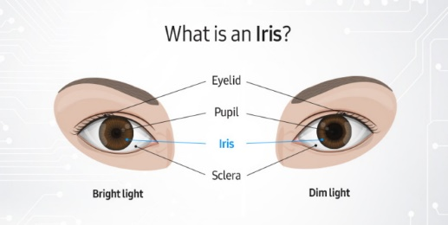
Iris Biometrics
Iris is externally Visible, coloured ring around the pupil
Iris is stable throughout life
Unique patterns of iris are not related to genetic factors
Both right and left eye have non-matching iris patterns
The flowery pattern is unique for each individual
Randomness

Slide 6
WHY IRIS RECOGNITION..?
ACCURACY: False acceptance & false rejection rate is very low.
SCALABILITY: used in both small and large scale programs.
STABLE : Iris patterns remains stable throughout an individual’s life. It is protected by the body’s own mechanism.
EASY TO USE: Iris recognition system is plug & play
DISTANCE: iris scanning can be done from a normal distance
FAST: can complete the process within just a few seconds. If the initial enrolment has taken place, it works faster than other modalities.
NON-INTRUSIVE: A person doesn’t need physical contact with the devices to perform an iris scan

Slide 7
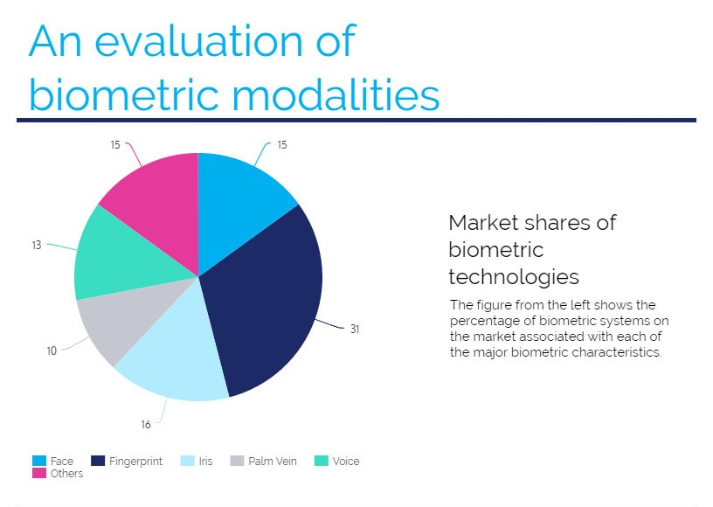
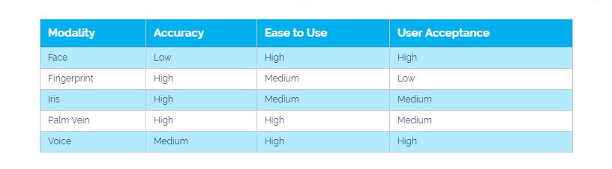


Slide 8
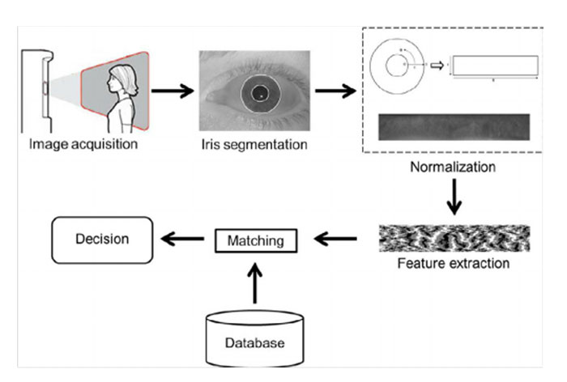
Brief overview of System Model

Slide 9
Detailed Overview of System Model

Slide 10
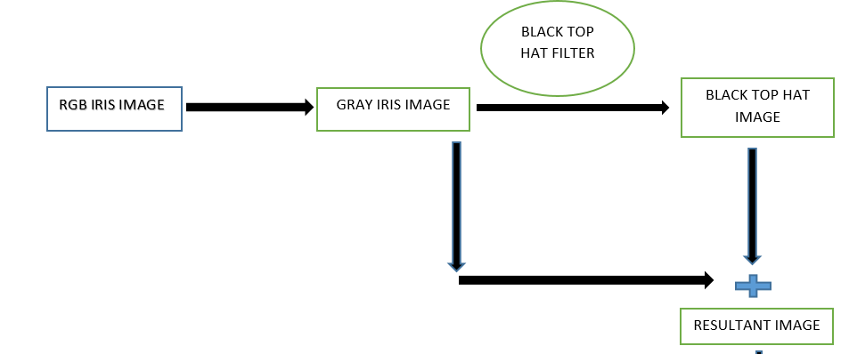
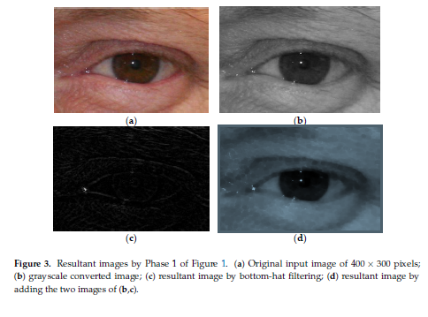

Slide 11
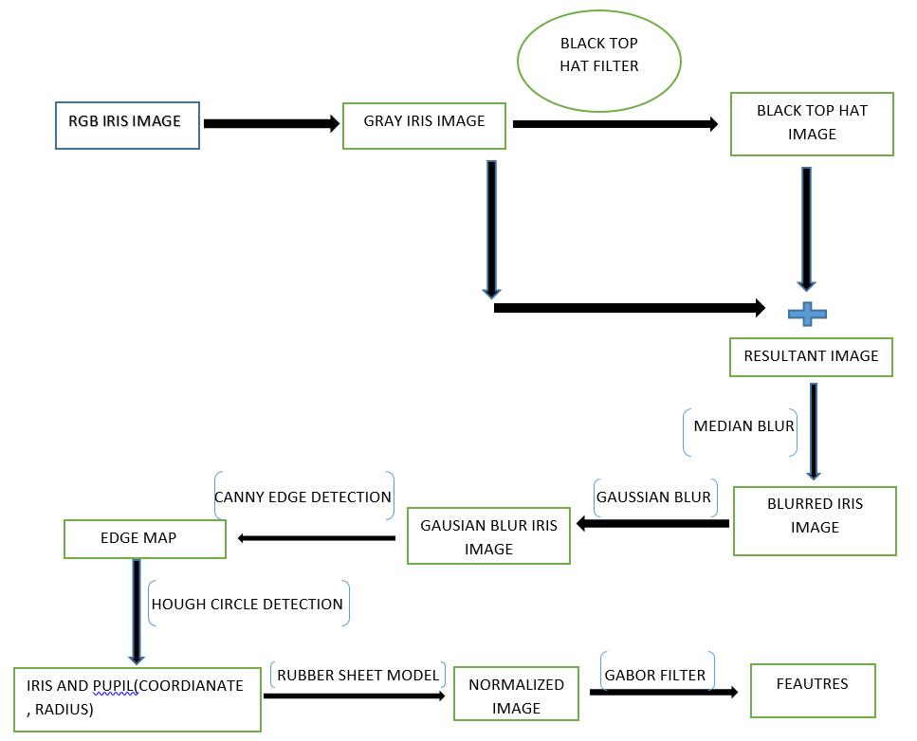
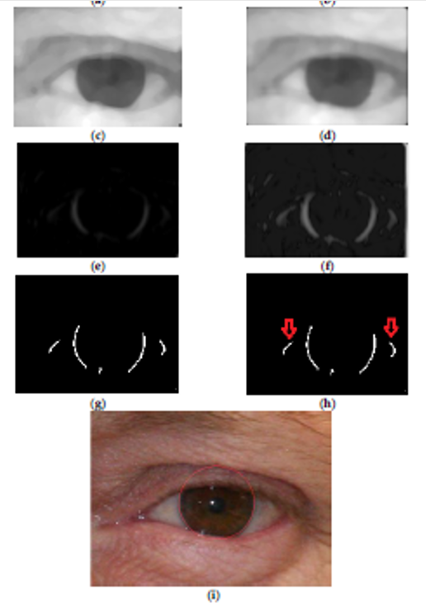
Detailed Overview of System Model

Slide 12
SEGMENTATION

Slide 13
Processes used in Segmentation
Isolate the actual iris region from eyelids and eyelashes
Methods used according to Proposed Principle
Circle Hough Transform
Problems with Segmentation
Orientation of the eye image
Low contrast between iris and pupil
Most work on iris segmentation is a variation and enhancement of Wildes’ approach
*Wildes first detects edges in the eye image and then applies a circular Hough tranform to find circular pupil and iris boundaries.

Slide 14
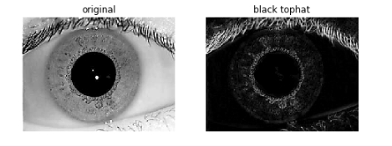
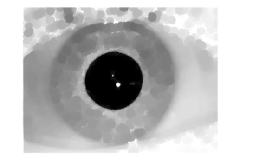
Use black top-hat filter then Combine filtered image with the actual gray image
The black top-hat transform is defined dually as the difference between the closing and the input image.
T(f) = f * b – f
resultant image = filtered image + original gray image
Resultant image

Slide 15
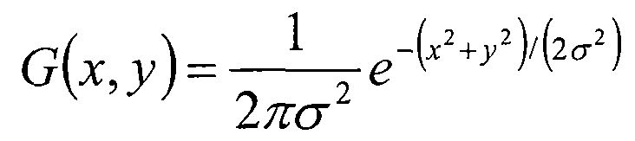
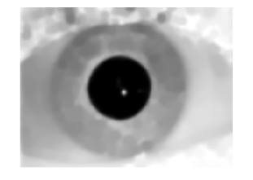
Use smoothing filter (Median & Gaussian)
Median Filter:
The main idea of the median filter is to run through the signal entry by entry, replacing each entry with the median of neighboring entries. The pattern of neighbors is called the "window", which slides, entry by entry, over the entire signal. For 1D signals, the most obvious window is just the first few preceding and following entries, whereas for 2D (or higher-dimensional) signals such as images, more complex window patterns are possible (such as "box" or "cross" patterns)
Gaussian Filter:
The Gaussian blur is a type of image-blurring filter that uses a Gaussian function (which also expresses the normal distribution in statistics) for calculating the transformation to apply to each pixel in the image. The formula of a Gaussian function in one dimension is
In two dimensions, it is the product of two such Gaussian functions, one in each dimension:
After gaussian smoothing Filtering

Slide 16
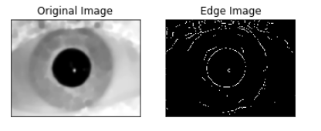
canny edge detection
Canny edge detection is a technique to extract useful structural information from different vision objects and dramatically reduce the amount of data to be processed. It has been widely applied in various computer vision systems. Canny has found that the requirements for the application of edge detection on diverse vision systems are relatively similar. Thus, an edge detection solution to address these requirements can be implemented in a wide range of situations

Slide 17
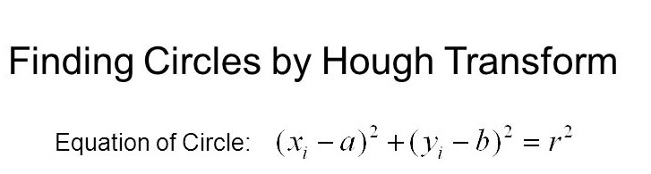
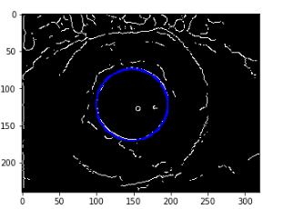
Circular hough transform to get the right boundary
The circle Hough Transform (CHT) is a feature extraction technique for detecting circles.
It is a specialization of Hough Transform. The purpose of the technique is to find circles in imperfect image inputs.
The circle candidates are produced by “voting” in the Hough parameter space and then select the local maxima in a so-called accumulator matrix.
Circle detection using circular hough transformation

Slide 18
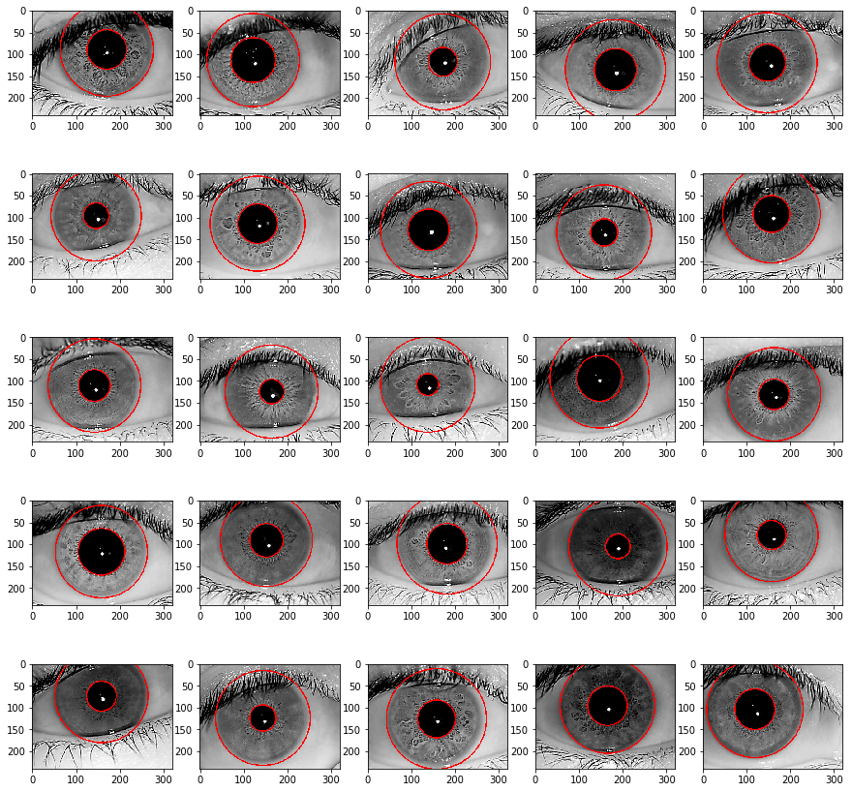
Results of Segmentation

Slide 19
NORMALISATION

Slide 20
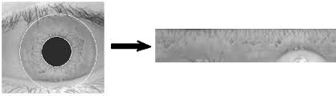
Segmentation method
Once the iris segmented, the next stage transform the iris region so that it has fixed dimensions in order to allow comparisons.
Produces iris region nullifying the effects of dimensional inconsistencies.
Normalization process involves unwrapping the iris and converting it in to its polar equivalent.
Seperating only the annular iris ring thus eliminating pupil and other regions.

Slide 21
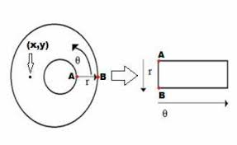
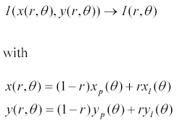
Daugman’s Rubber Sheet Model
Model doesn’t compensate for rotational inconsistencies.
Remaps each point within iris region to a pair of polar coordinates.
The remapping of the iris region from (x,y) Cartesian coordinates to the normalised non-concentric polar representation is modelled as

Slide 22
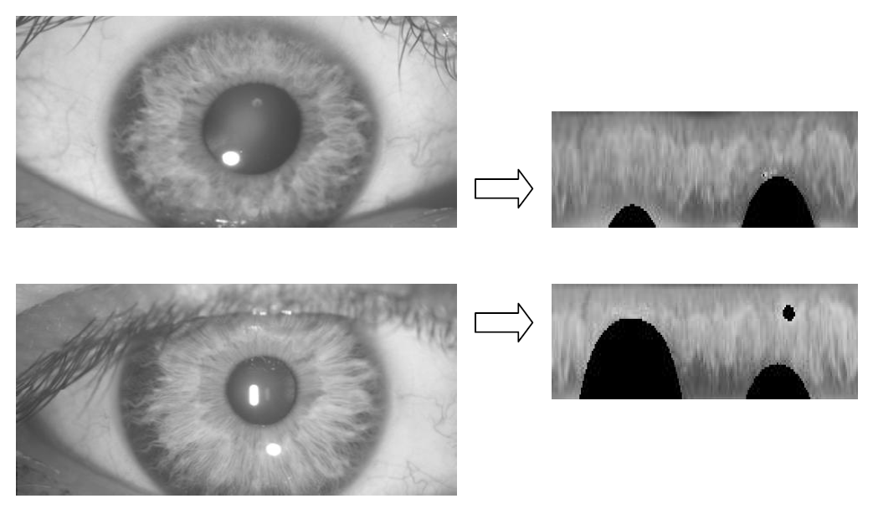
Result
The normalisation process was not able to perfectly reconstruct the same pattern from images with varying amounts of pupil dilation, since deformation of the iris results in small changes of its surface patterns.

Slide 23
FEATURE ENCODING & MATCHING

Slide 24
Feature Encoding
We use Gabor filter banks for texture classification for determining and storing the features of a certain image. Here the Gabor Kernel is used to classify textures based on Gabor filter banks.
In this method we first create a null matrix as the container for the kernel which is to be created.
The kernel is just the template for extracting the feature from the given image as it scans through the whole image and applies gabor filter kernel which figure outs the characteristics or feature of certain different points in the image.

Slide 25
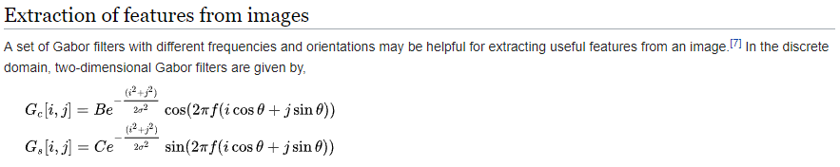
Feature Encoding

Slide 26
Matching
After we have successfully recorded the unique features of every image and stored them in suitable Data Structure, Its time for us to retrieve information by searching by a certain image file or index which is stored in the Data structure (Multi-dimensional array) and match them with the current image in examination. That is as different template containing different information are stored in the array then we match the image under observation with all the stored templates in the array and check the matching percentage and we announce the image with the highest percentage of matched ratio, as the probable image complementary to the image under observation currently.
Now this method proves to be efficient as we match with all the image templates available and we compare the percentages of the matching ratios and thus we can be fairly assured of that the image is accurately identified , As we can guarantee that even right and left eye images of a single person would give huge differences’ in matching percentages ratio thus it nearly works as Hamming distance method.
Though we do not directly implement the Hamming distance method, still we reach the same milestone of accurately finding the image by only using Gabor filter and applying kernels to retrieve or match the extracted features.

Slide 27
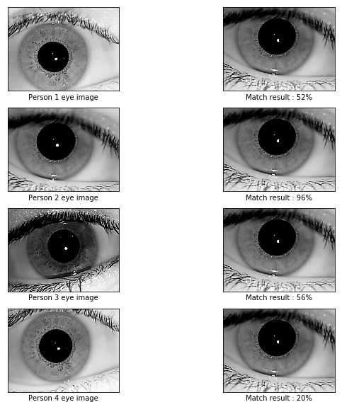
Results of matching of eye image with percentage

Slide 28
Conclusion
Iris recognition has proven to be a very useful and versatile security measure.
It is a quick and accurate way of identifying an individual with no chance for human error.
Iris recognition is widely used in the transportation industry and can have many applications in other fields where security is necessary.
Iris recognition will prove to be a widely used security measure in the future.

Slide 29
Future Work
Every human being has a unique Iris pattern, even the twins possesses different unique Iris patterns, thus we can say it is a dependable means of identifying any animal species. Most interestingly Iris pattern and its uniqueness do not only stop in identifying human being, it has a very widespread application in various sectors of modern-day life. Aviation industry uses Iris pattern recognition for various purposes including security etc.Quite naturally it is one of the most dependable authentication schemes. But Iris tells us more than we think-Iris pattern can be studied to find out potential diseases’ symptoms. Recently Google published their research paper on Diabetes detection using Iris pattern-In this project our first aim is to successfully execute the human identification but we are eyeing a bigger goal that is detecting medical condition by observing the Iris pattern, that will be a breakthrough if we can achieve this.

Slide 30
References
http://www.cl.cam.ac.uk
http://en.wikipedia.org/wiki/Iris_recognition
www.seminars4u.com
Daugman J (1999) "Biometric decision landscapes.“ Technical Report No TR482, University of Cambridge Computer Laboratory.
International Journal of Computer Technology and Electronics Engineering (IJCTEE) Volume 2, Issue 1

Slide 31
Thank You

